Slide 1
Electronics Club
Year Review 2014-2015

Slide 2
Vision!
We had a threefold vision and we believe we did proper justice to each of the flanks respectively.
Firstly, we wanted to make the club more informal with more hands on activities and follow up sessions. We managed to do so successfully, hackathons and Techify Your room paved way for this vision coming true. This also ensured that freshmen enthusiasm was not lost by the year end.
Second, we wanted to increase senior and PG participations and sponsored workshops like hardware hackathon and SSTeP ensured that, and we saw a much better response than last year.
Third, we wanted to make the work of conveners more technical than managerial, by developing RF module and TYR project mentoring we are pretty sure that they have increased their technical foundations.

Slide 3
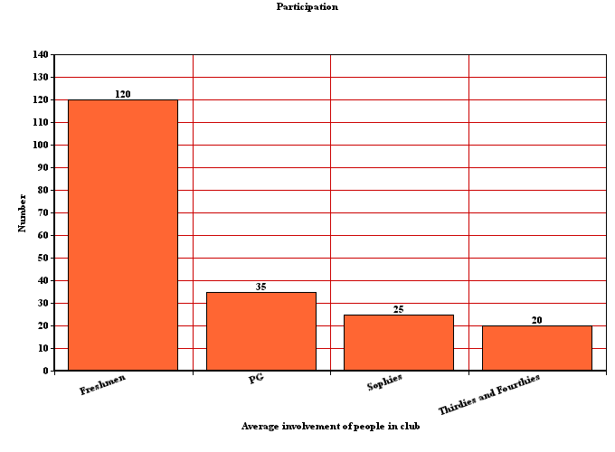
Participation throughout the year

Slide 4
Major Sessions(Old)
Electrified sessions (two installments)
Line Follower Competition followed by 'Techify your room'
Talk on Brain Machine Interface
'Electric Jatka' - GC
Harware Hackathon

Slide 5
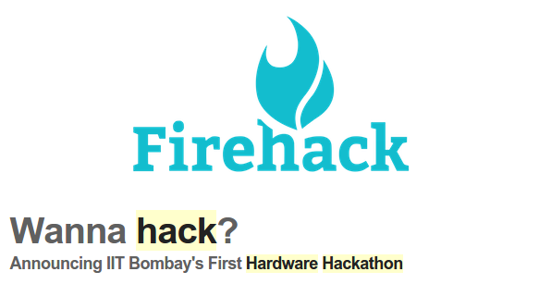
Hardware Hackathon
In collaboration with WnCC
14 teams participated
9 teams presented
Was well-received

Slide 6
Major Session(New)
Processing: There was a session on processing very recently, in fact our last venture. It was designed for freshmen and seniors to give first hand experience of the software called Processing which is extremely easy to use and can be used for various purposes. We had this session followed by an TYR, where we saw many amazing projects come true.
Strength: 50 participants both in session and in TYR
Response: Positive

Slide 7
Major Session(New)
Sessions on Microcontroller coding
There 4 sessions in the series
Average participation on 35 students, majorly freshmen

Slide 8

Talks
Brain Machine Interface : 40 participants, extremely positive response
Communications Protocols: 15 participants expected more, good response
Declutter Design (in SSTeP): 35 Participants, good response

Slide 9

BLAH Talks
Three Talks so far with average participation of 15 students.
Image Steganography
Cloud and IOT
Cryptology

Slide 10
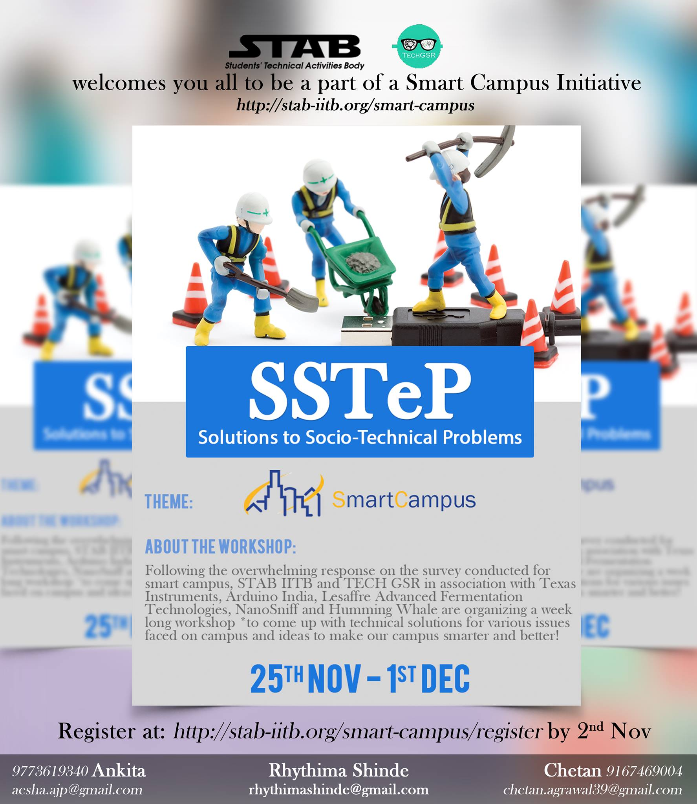
SSTeP
In collaboration with Robotics Club
Participation by 12 Teams and about 8 teams sucessfully demonstrated their idea
Two of the teams are taking their project further in collaboration with TechGSR and Technovation

Slide 11
Techify Your Room
Two Installments, one on arduino and one on processing
50 participants each
Around 14 successfully finished projects by freshmen in all

Slide 12
Annual Robotics Challenge
High prep GC: Theme - Smart Object
In collaboration with Robotics Club
Participation by 9 hostels

Slide 13
THANK YOU

